Slide 1
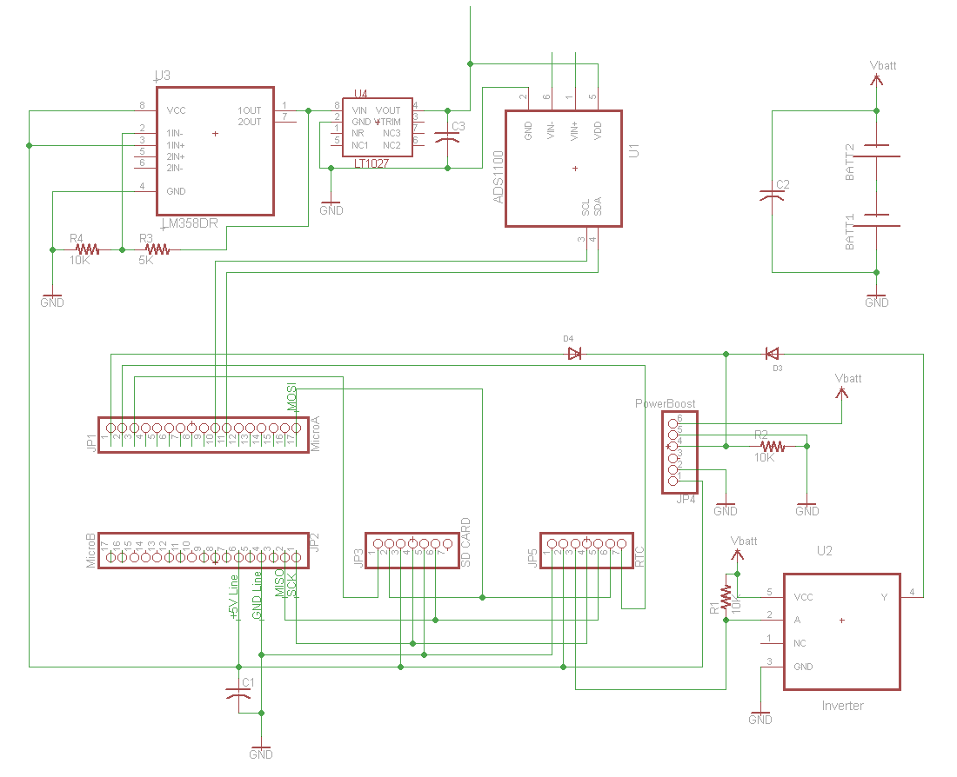
To Sensor Network
LM385 Op amp (Provides 10V
to LT1027)
LT1027 Provides 5V
+/- 0.001%
Power Supply Can be between
1.8 and 5.5V
ADS1100
16-Bit ADC
Better than
built-in 10-Bit
Diodes allow RTC to wake up unit and Arduino to shut of unit via “Enable Pin” on PowerBoost
Boost Converter Provides power converter and shutoff function
Micro Arduino Programmable Micro-controller
SDCARD Provides up to 4GB Storage
DS3234 RTC Provides time and alarm
Signal Inverter Converts RTC Alarm to proper Voltage

